Slide 1
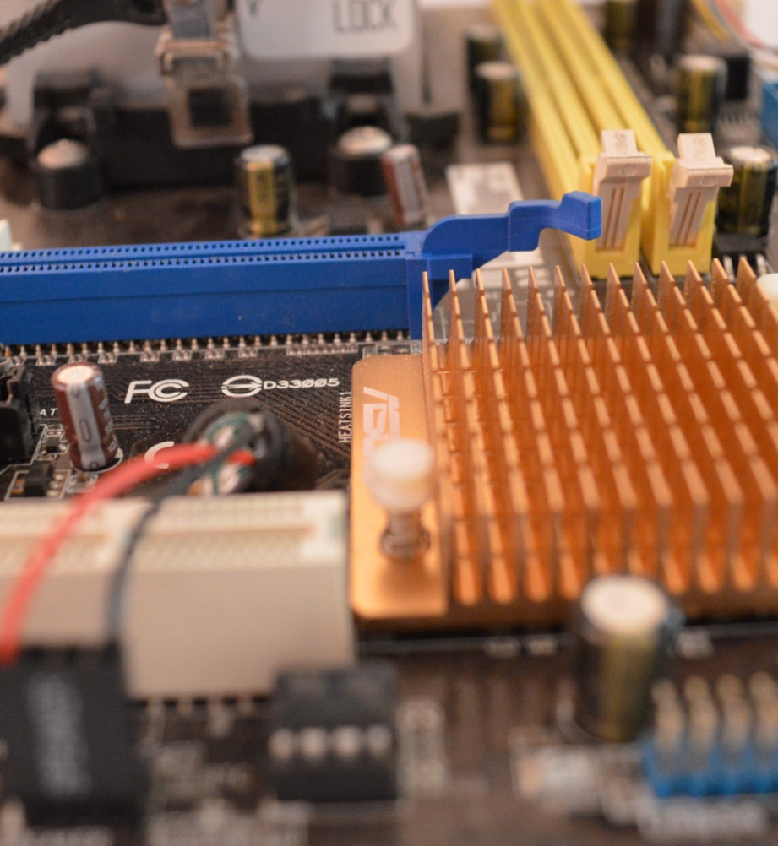
Computer Science
Transition workbook
The topic of Computer Science is at the heart of the modern world
Studying it can make you extremely sought after in todays job market
The transition from GCSE to A level is significant, this includes:
  An increased emphasis on technical content
  An increased emphasis independent research
This workbook is designed to allow you to practice some of these skills and build on your existing knowledge.
Please complete by your first lesson back in September.
We are using OCR exam board

Slide 2
1
“Tell me about yourself”
Why did you choose Computer Science?
Expected time to complete: ½ hour
In this simple task you get the opportunity to tell me your choices and reasons behind choosing to study Computer Science. Please answer all questions as best you can.
1. Why did you choose to study A level Computer Science?
2. What other courses have you chosen to study at Key Stage 5, and what made you choose this combination?
3. What are you hoping to achieve from studying Computer Science?
4. How would you describe yourself as a learner at GCSE? What skills where you good at, what areas would you like to improve on?
5. What are your other hobbies and interests outside of school? Anything related to Computing?

Slide 3
2
Independent research task
Use a Word document
Emerging computer technology
Expected time to complete: 2 hours
In this task you get to investigate any area of emerging computer technology which interests you.
You can pick any area which interests you, but examples could be:
Artificial intelligence
Robotics
Automated self driving cards
Quantum computing
In no more than ONE side of A4 summarise the area you have chosen under the following four headings:
What is it?
What are the possible Social, Moral, Cultural and Ethical benefits of this technology on society
What are the possible Social, Moral, Cultural and Ethical risks of this technology on society
My conclusion on this technology and what it will mean for our world 10 years from now
Additional help:
For additional help and support in structuring your answer you might like to watch some of the videos from the following Craig ‘n’ Dave playlists:
OCR:
SLR 17 – Ethical, morale and cultural issues
https://student.craigndave.org/videos/slr-17-ethical-moral-and-cultural-issues

Slide 4
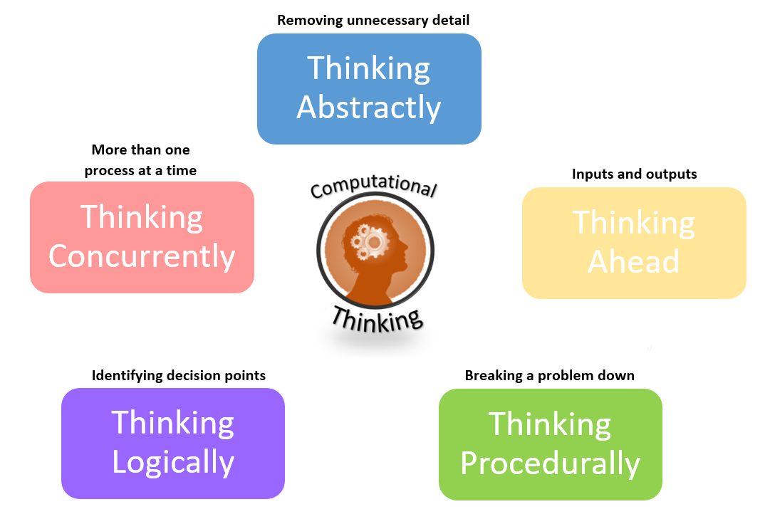
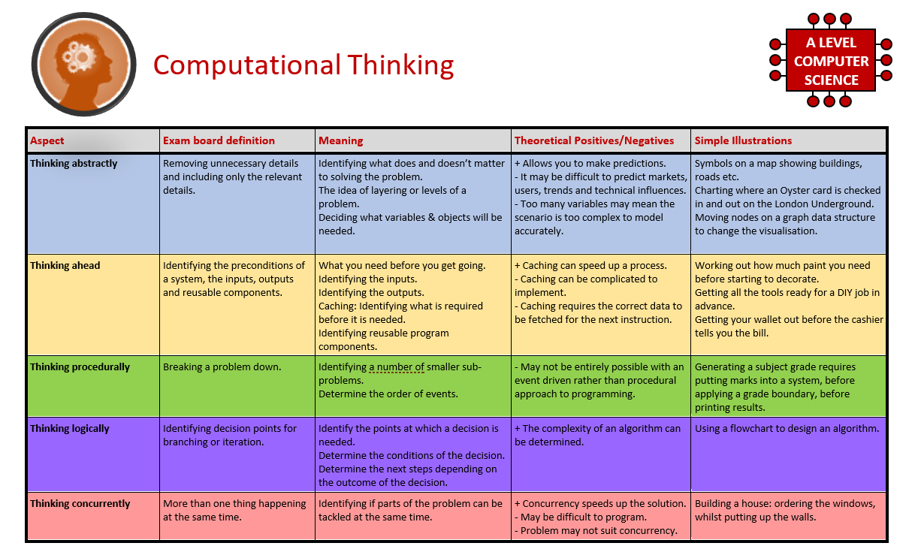
3
What is “computational thinking”?
Thinking like a computer
Expected time to complete: 2 hours
At the heart of Computer Science is the ability to look at problems, analyse them, break them down and solve them in a way which involves a variety of “Computational Thinking” skills.
Create your own spider diagram / mind map which shows your clear understanding of the 5 different computational thinking strands
  Keep it to a single side of A4 / A3
Your goal is to imagine someone else has to revise from your mind map. Ask yourself:
  Does it make sense?
  Is it clear?
  Does it cover all of the important concepts?
Note:
Although the five strands listed (and the download resources provided for this task) are from the OCR AS / A’Level specification, the concepts of “Computational Thinking” are just as applicable to the AQA course.

Slide 5
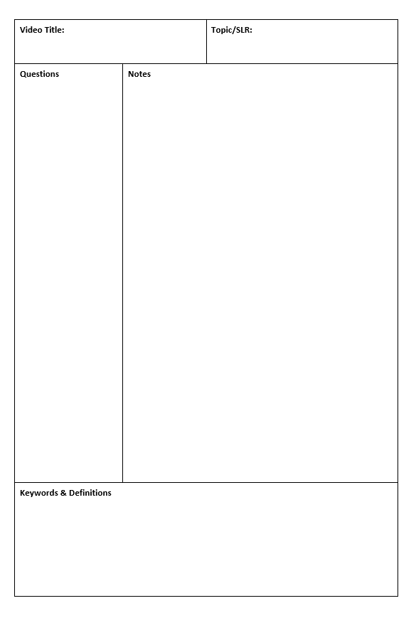
4
Note taking practice task
Use a Word document
The Cornell method of note taking
Expected time to complete: 1½ hours
The expectation to do independent research at A Level will increase dramatically from GCSE.
There is a real skill to taking decent notes outside of lesson which are of value. Research has proven that one of the most effective methods is the “Cornell” note taking method.
Pick any two of the following videos from Craig ‘n’ Dave:
  OCR: https://student.craigndave.org/videos/ocr-alevel-slr01-alu-cu-registers-and-buses
  OCR: https://student.craigndave.org/videos/ocr-alevel-slr04-paging-segmentation-and-virtual-memory
  OCR: https://student.craigndave.org/videos/ocr-alevel-slr05-stages-of-compilation
  OCR: https://student.craigndave.org/videos/ocr-alevel-slr14-data-structures-part-2-graphs
Write the title of the video and its topic in the top boxes (use a different sheet for each video).
In the main “Notes” section, write notes from the video. You can do this in any way you like, a suggestion might be to rewind slightly when the canvas changes, thinking carefully about what was important in the previous few minutes.
Having recorded the notes, review them:
  Turn each part into a question in the section on the left.
  For example, the notes may say, “The value of the program counter is passed to the memory address register”.
  The question then becomes, “which register is the value of the program counter passed to?”
  Sometimes these questions are easy, and at times they are more difficult to write.
  There may also be more than one valid question.
  You will need to decide for yourself which are the most appropriate questions for revision.
Finally pull out all the key words and their definitions words the notes and list them in the bottom section.

Slide 6
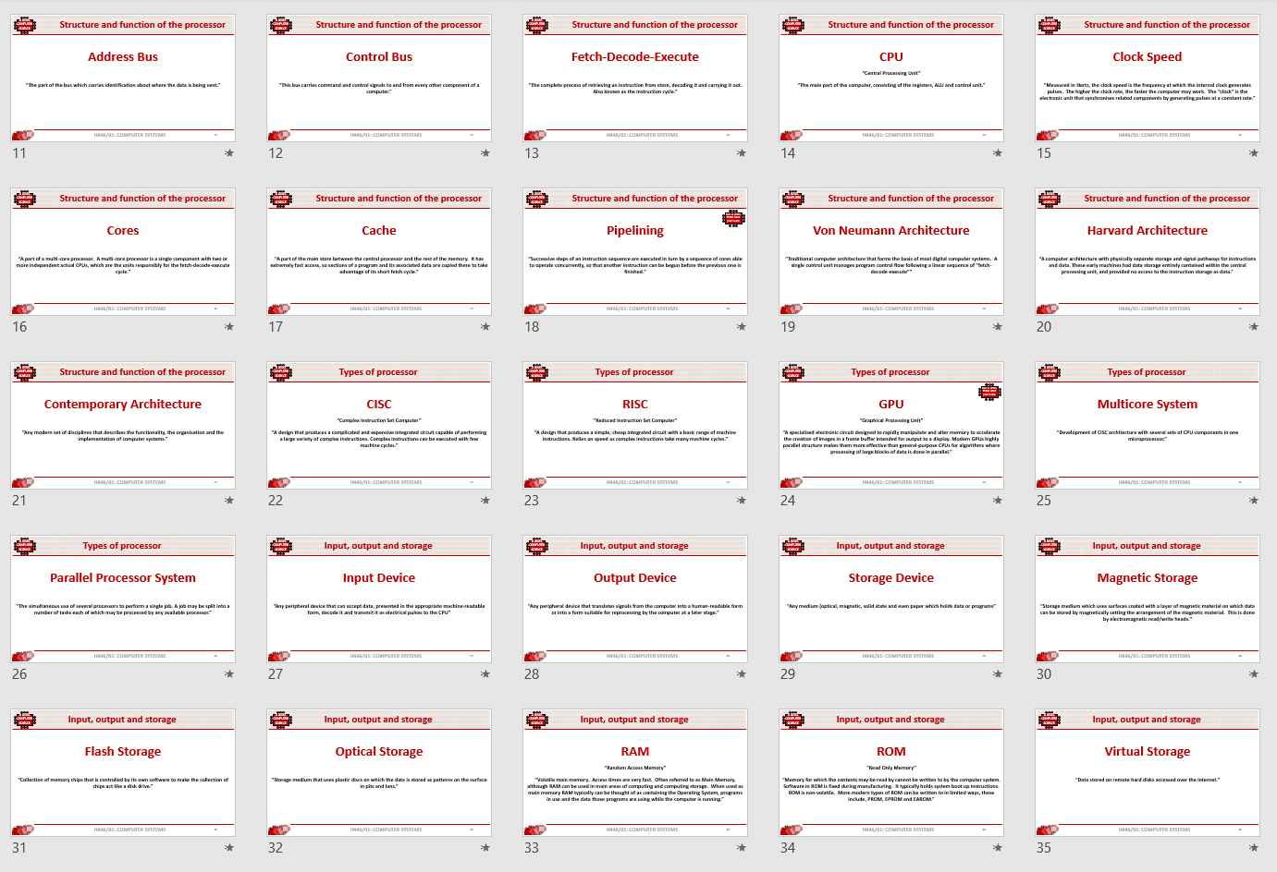
5
Key terms task
Getting to grips with terminology
Expected time to complete: 2 hours
An important aspect of being successful with your study of Computer Science is getting to grips with subject related terminology. There are over 240 specific terms you will need to learn!
Below are a handful of the key terms you will need to become familiar with.
Control Unit Register Busses
Von Neuman Architecture Optical Storage Operating System
Intermediate Code Device Driver Compiler
Assembly Language Machine Code Lossy Compression
Hashing Normalisation TCP/IP Stack
Packet Switching ASCII Problem Decomposition
Research each of the key terms and write a definition.
Resist the urge to simply cut and paste a definition from the first website you find.
Many definitions found on The Internet are overly complicated and wordy.
Ask yourself:
  Does my definition make sense?
  Is it succinct, to the point?
  Does the definition have appropriate depth and detail for A’Level?
  Could I give this definition to another student so they could revise from it?

