Slide 1

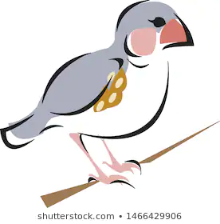
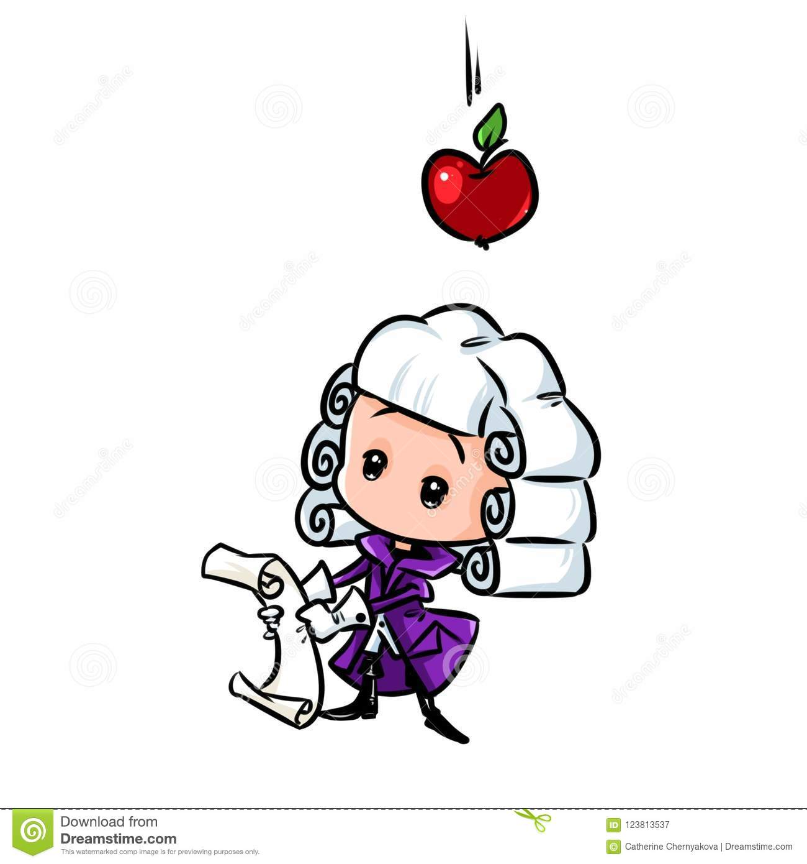

Science
Key Skills in Science
Know key words
Understand how Scientific experiments are carried out
Be able to evaluate an experiment in order to improve results
Understand the difference between facts and opinions
What you can be doing now!
Task 1
Watch the short videos in each of the categories below. Complete the short activities on each link.
Task 2
Pick one of the Scientists given below and explain how they made their discovery using either:
- A cartoon
- A newspaper report
- A story
Link 1: Microorganisms
Link 2: Adaptation
Link 3: Gravity
Scientist: The method by which living things develop adaptations was suggested by Charles Darwin. Darwin’s method of “Survival of the Fittest” is the core to explaining Evolution.
Scientist: Before Sir Isaac Newton, there was no real explanation for why objects fell to Earth. He used experimentation and mathematics to explain it.
Scientist: Antibiotics can be used to kill bacteria when someone has an infection. They were discovered by Alexander Fleming.
Microorganisms
Adaptation
Gravity

