Slide 1
All Saints’ Revision Support 18.01.22
‘We shall serve’

Slide 2
Session Outline
The Research
Learning how to revise
Revision Timetables
How you can support at home
‘We shall serve’

Slide 3
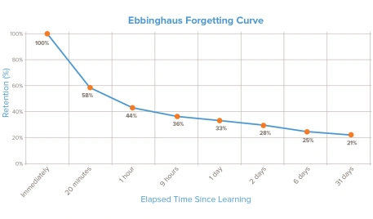
The Research
‘We shall serve’

Slide 4
The Research
‘We shall serve’

Slide 5
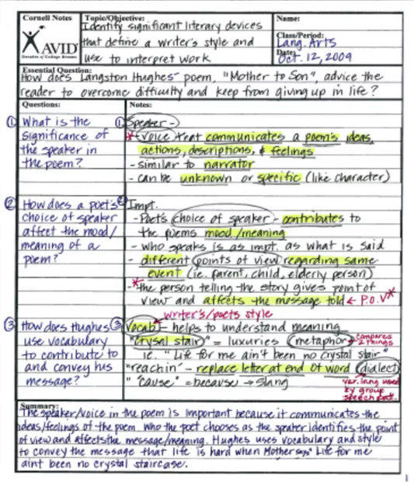
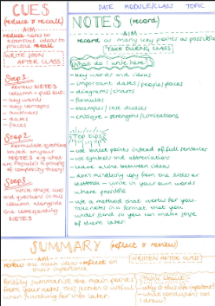
Cornell notes – how?
‘We shall serve’

Slide 6
‘We shall serve’
Source: https://emc2andallthat.wordpress.com/

Slide 7
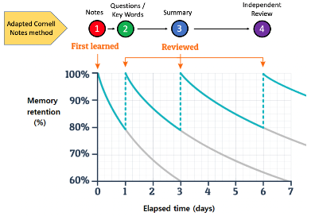
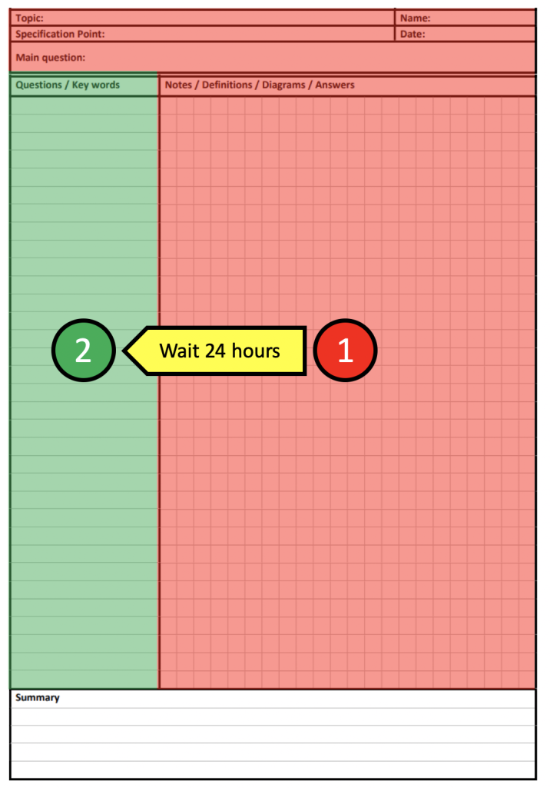
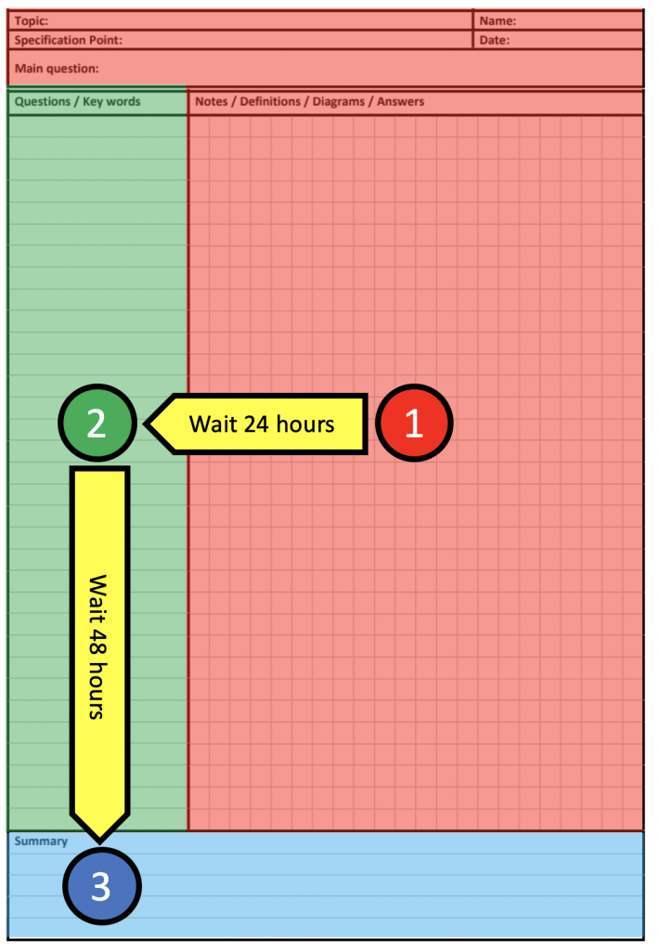
‘We shall serve’

Slide 8
Learning How To Revise/ Homework
Independent Learning Time
Instructional Videos
Use of Absolutes
Tutors available to support
Homework timetables are in planners
‘We shall serve’

Slide 9
Discipline v Motivation
Repeated action forms habits
Habit formation takes time
Big goals v small habits
Where and when
Break down our expectations
Demonstrate the value (links to lessons)
Cost- benefits (short sighted)
Importance of peer role models
Clear modelling of expectations and standards
Spaced practice (quiz design)
Know the techniques but do not use them (Blaisman)
Over-confident (Sullivan)
Students avoid self-quizzing (Karpicke)
Testing gives a better understanding of knowledge (Roedigger)
‘We shall serve’

Slide 10
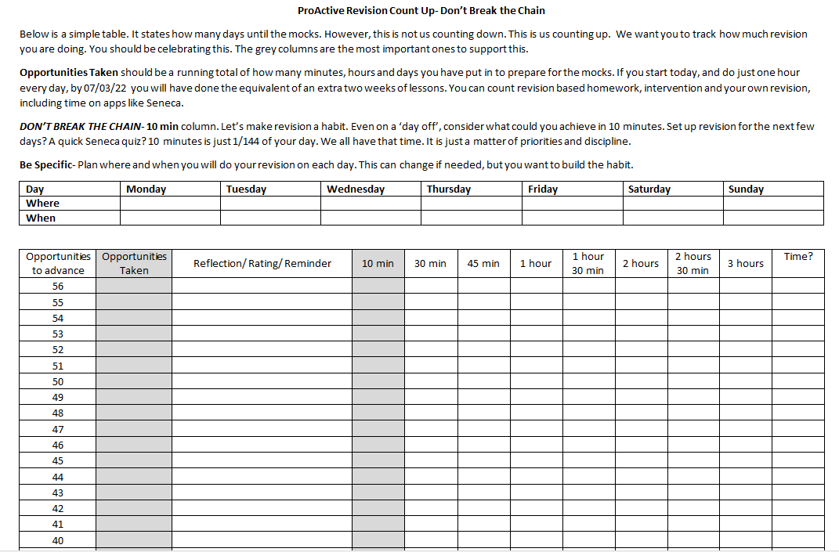
Discipline v Motivation
Counting up, not down
Making revision a habit
Tracking and celebrating effort and progress
Reflecting
‘We shall serve’

Slide 11
‘We shall serve’

Slide 12
All Saints’ Top 3 Revision Techniques
Look, Say, Cover, Write, Check
Brain Dumps
Quiz Questions/ Flash cards
Students should not be merely copying information.
‘We shall serve’

Slide 13
Quizzing and overconfidence
Seeing the correct answer makes us think we know something
Seeing the correct answer may mean we ignore the gaps we have
Boys are more likely to be overconfident in their knowledge than girls
It can make us feel we don’t need to revise
‘We shall serve’

Slide 14
The things we do that we think are helping
Reading and Highlighting- leads to over confidence
Making a lot of resources and not using them
Accepting partial answers
Busy work (copying notes) without checking
‘We shall serve’

Slide 15
Exam Timetables- DOs and DON’Ts
‘We shall serve’

Slide 16
Exam Timetables- DOs and DON’Ts
C | Mon | Tue | Wed
40min | English Lit- Macbeth | Maths Calculator | Science Biology
30min | Science Physics | RE Catholicism | English Lit- ACC
20min | RE Judaism | English Lang- non fiction | Maths Non- calculator
‘We shall serve’

Slide 17
Exam Timetables- DOs and DON’Ts
D | Mon | Tue | Wed
40min | English Lit- Macbeth Themes of Kingship and Supernatural | Maths Calculator Trigonometry | Science Biology Macromolecules. Carbohydrates. Lipids
30min | Science Physics Energy demands, stores and efficiency | RE Catholicism God, Creation and morality | English Lit- ACC How the ghosts are significant to the text as a whole
20min | RE Judaism Life after death and revelations | English Lang- non fiction Letter and report writing formats | Maths Non- calculator Quadratic equations
‘We shall serve’

Slide 18
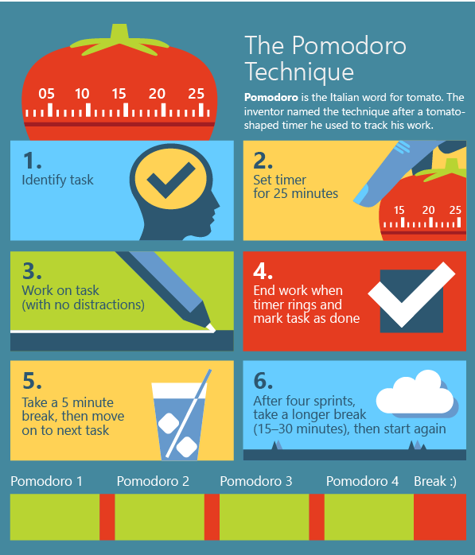
Managing time and staying focussed
‘We shall serve’

Slide 19
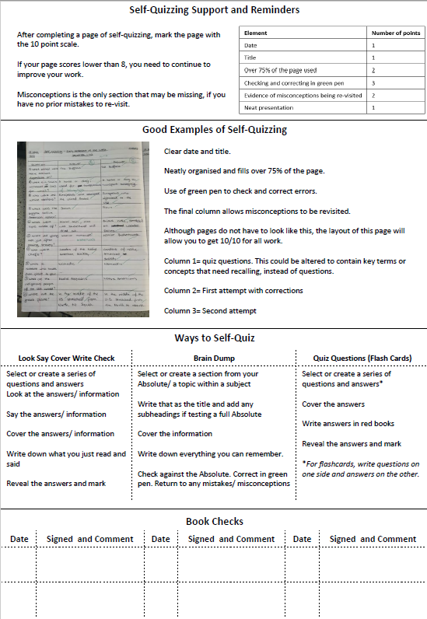
How to support at home
Supporting with time management and removing distractions.
Have they show you how they have checked their work and ask what their next steps are.
Ask them questions or to tell you what they know about certain topics.
Are they sticking to their revision timetable
‘We shall serve’

Slide 20
Time for Q&A
‘We shall serve’

