Slide 1

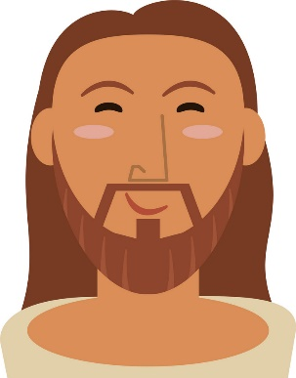
RE
Key Skills in RE
Know about the important figures in the Bible.
Know about how Catholics think, worship and act.
Be able to evaluate all the ideas we look at.
Have an opinion!!
What you can be doing now!
Understand the key ideas within Roman Catholicism
Watch this clip regularly and try and remember a NEW fact each time you watch it. https://safeYouTube.net/w/eLy8
Explore the list of ‘All Saints’ https://mycatholic.life/saints/
Find your favourite Saint
Research the Saint – their life and why they became a Saint.
Write a short piece about how this Saint could be a good role model for you as you start as a year 7 at All Saints’.

