Slide 1


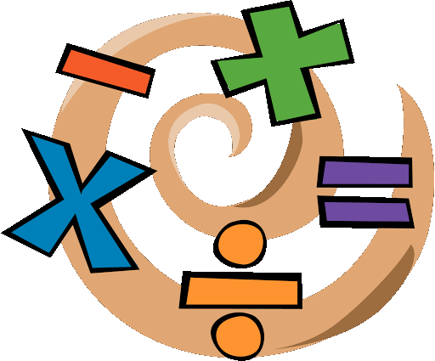
Maths
Key Skills in Maths
To be able to recall mathematical facts and apply them rapidly and accurately
To be able to reason mathematically.
To be able to solve mathematical problems.
What you can be doing now!
Practice your times tables so that you can recall them quickly.
Here is a good website you may like to try:
  https://www.topmarks.co.uk/maths-games/7-11-years/times-tables
Choose a minimum of 3 activities from the maths transition booklet to complete. (Booklet included in this folder)
  Activities you could choose from include:
  Word search Colour by Number Broken Calculator
  Famous Mathematicians Key Terms Riddles
Number links investigation Lagrange’s Theorem

