Slide 1
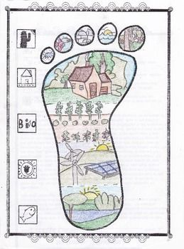
Geography
What you can do to prepare for Geography lessons:
1. What is your family’s ecological footprint like?
Look at the geography that surrounds you and ask questions.
What technology/clothing brands do you have at home, and where do those brands originate? (Clothing labels will help or research online)
How much water does your household use? Baths or showers? How many people? (Think about things like tooth brushing – tap on or off?)
What plants and animals live in your garden? (Types of trees, bushes, flowers, birds, insects, rodents?)
Where has the food for your meals come from? (Where was the food grown or made, not the shop you bought it from!)
How does the electricity you use at home/in a car affect the environment? (How is the electricity made? What is pollution?)
Use these ideas to design a poster to show your household’s ecological footprint.
Key Skills in Geography:
Appreciate different landscapes and cultures around the world
Understand how and why the world is changing
Consider the impact that people have had on the world’s environments
Use map, photo, data and numeracy skills to analyse and evaluate evidence about places
Use fieldwork skills to collect and analyse data to draw conclusions about a place
2. Find out more about geography….
Geography Now: https://safeYouTube.net/w/99N9
Map master: https://safeYouTube.net/w/3CN9
Earth Day: https://safeYouTube.net/w/ZGN9
Write a half page summary about the link, outlining
what it was about and what it has inspired you to do.
3.Become a map master….
Learn how to read maps and practise using maps on this link: https://www.ordnancesurvey.co.uk/mapzone/

